Slide 1

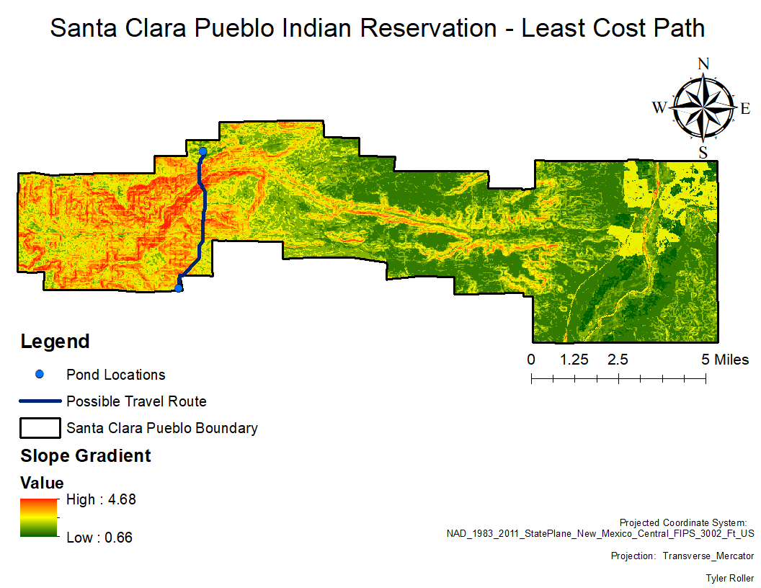
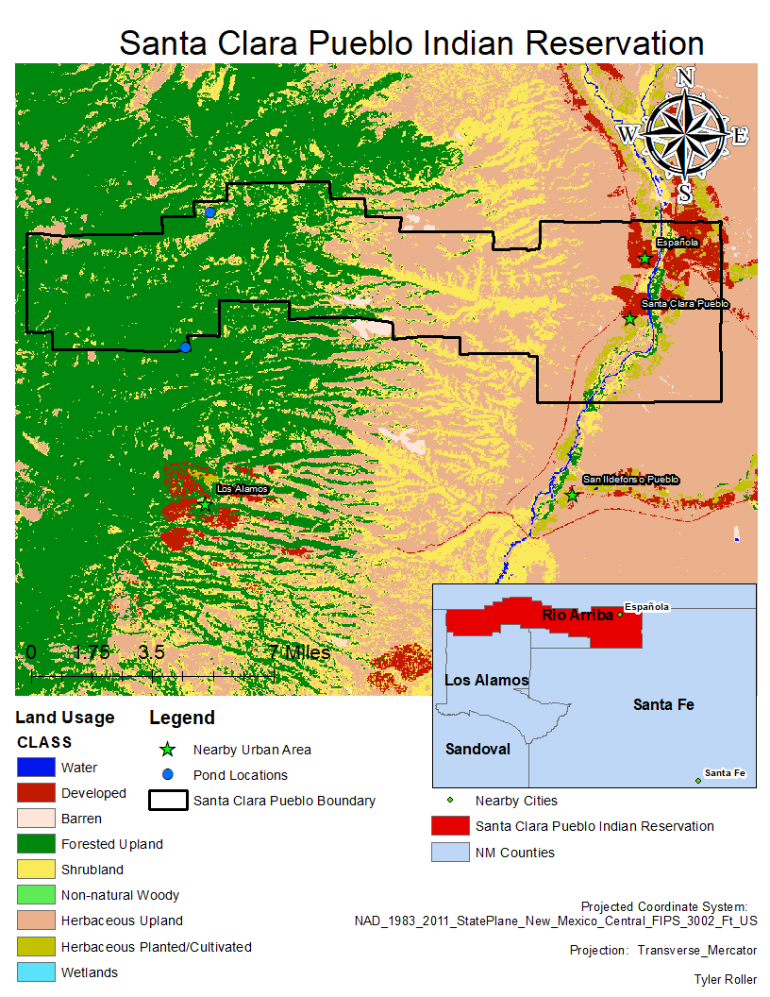
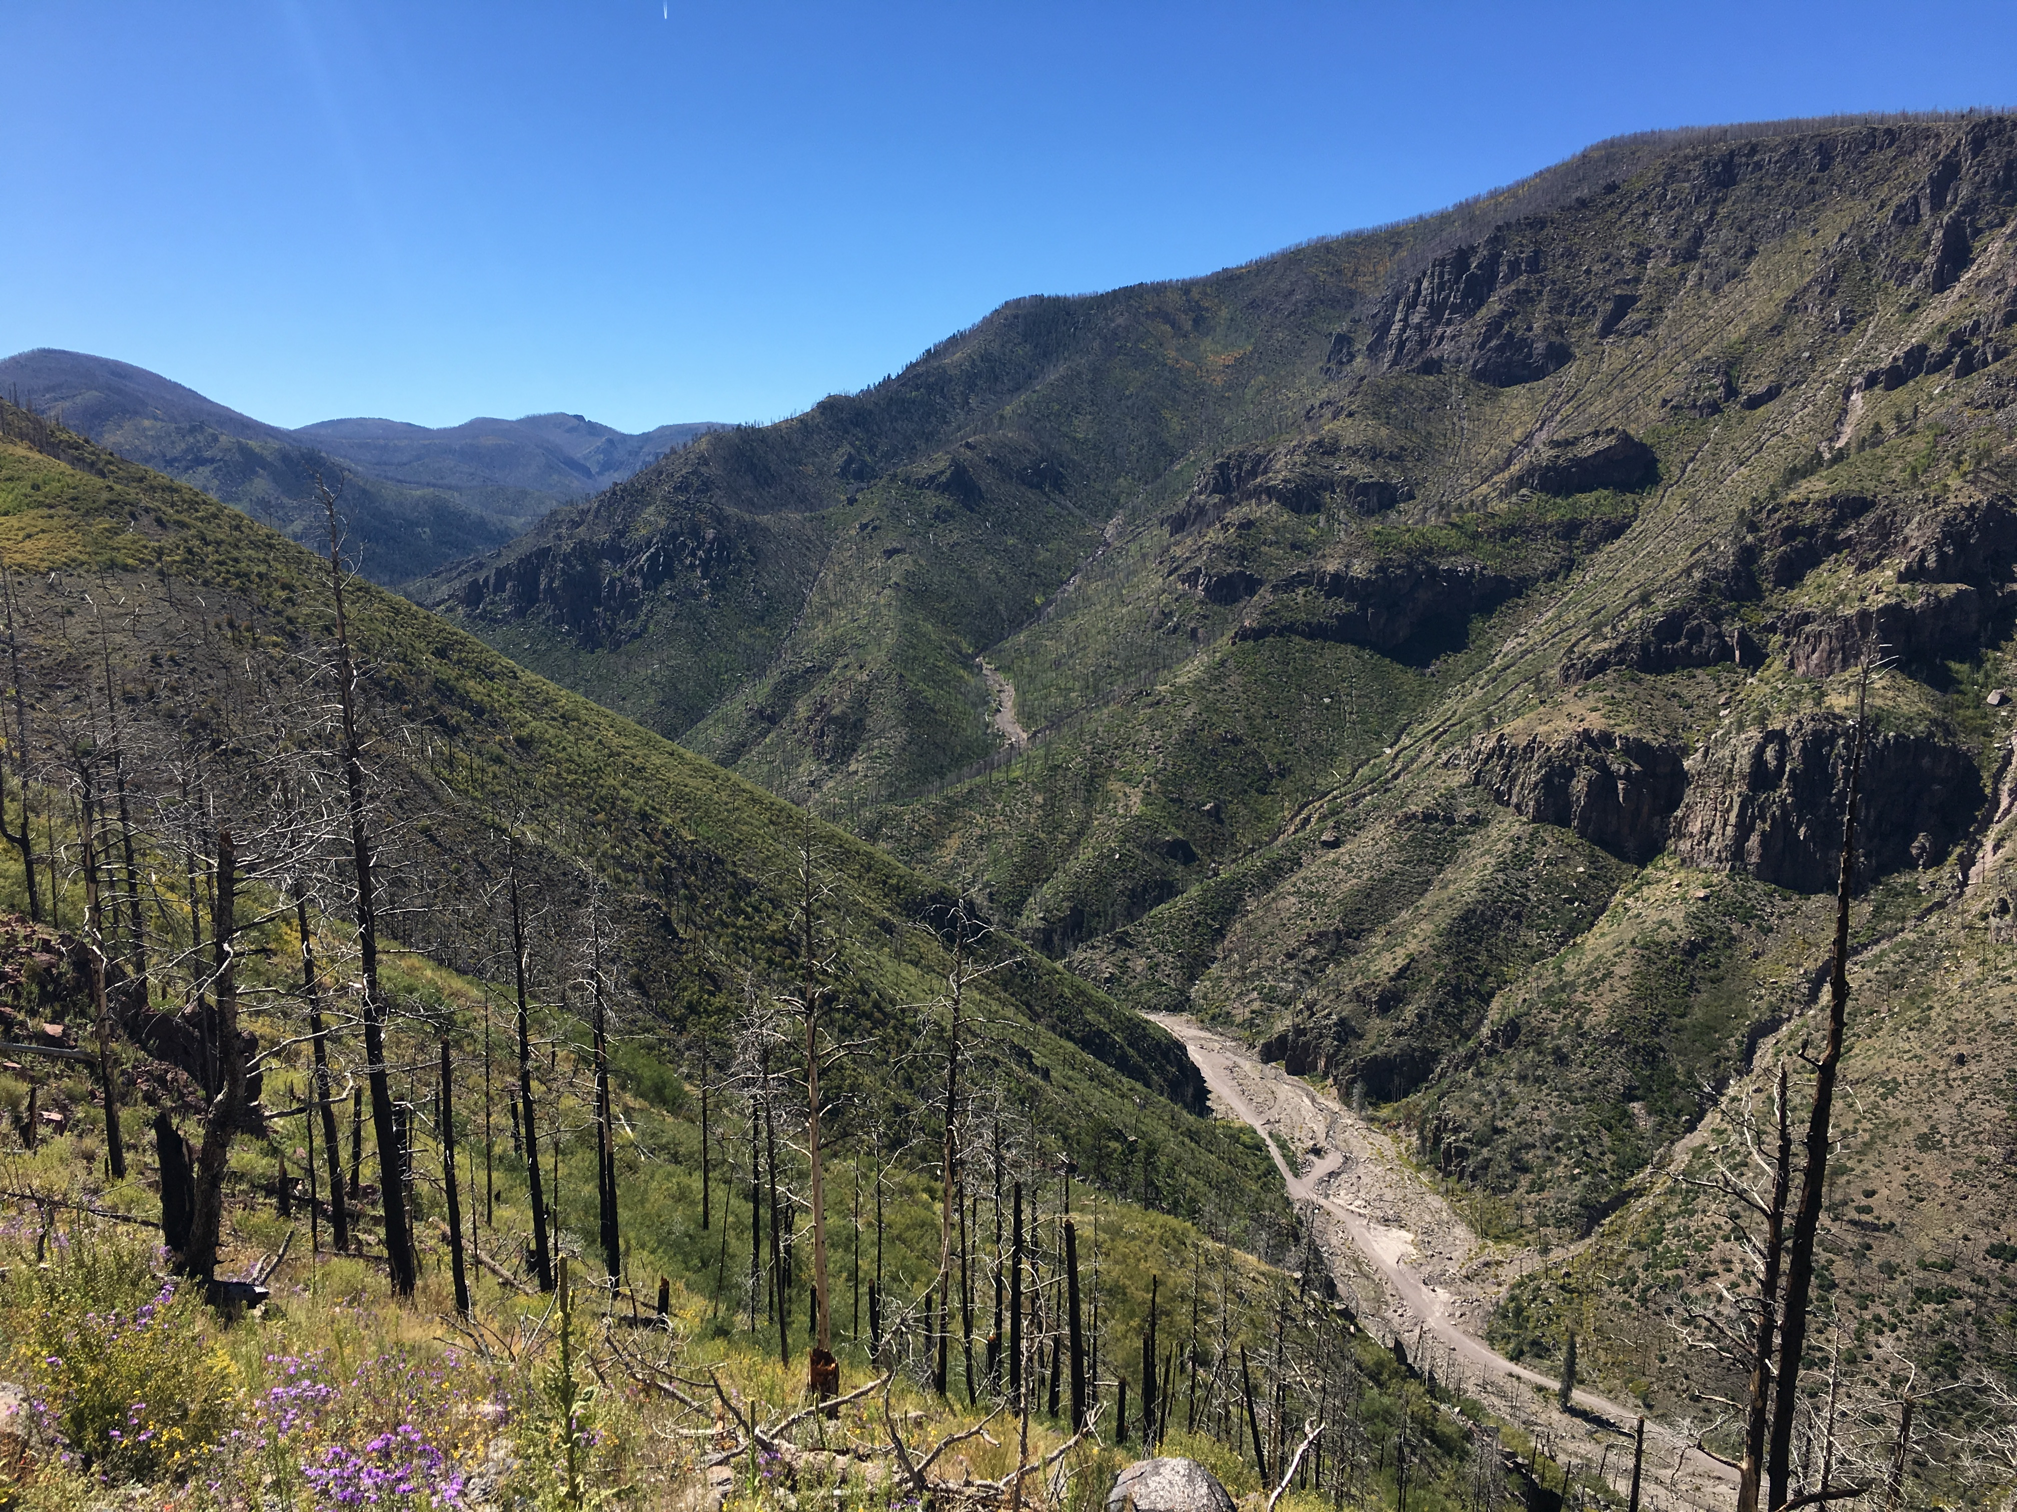
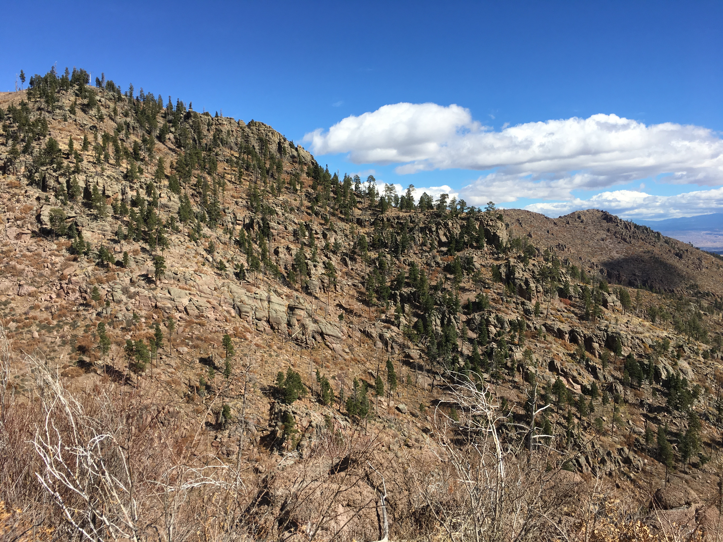
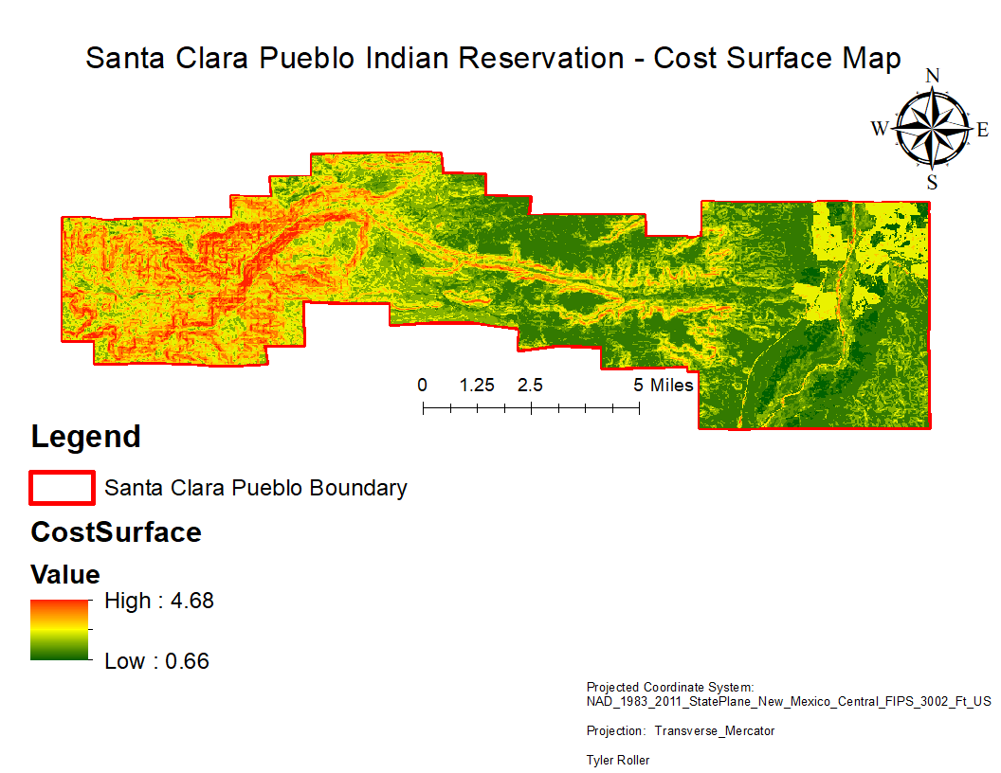
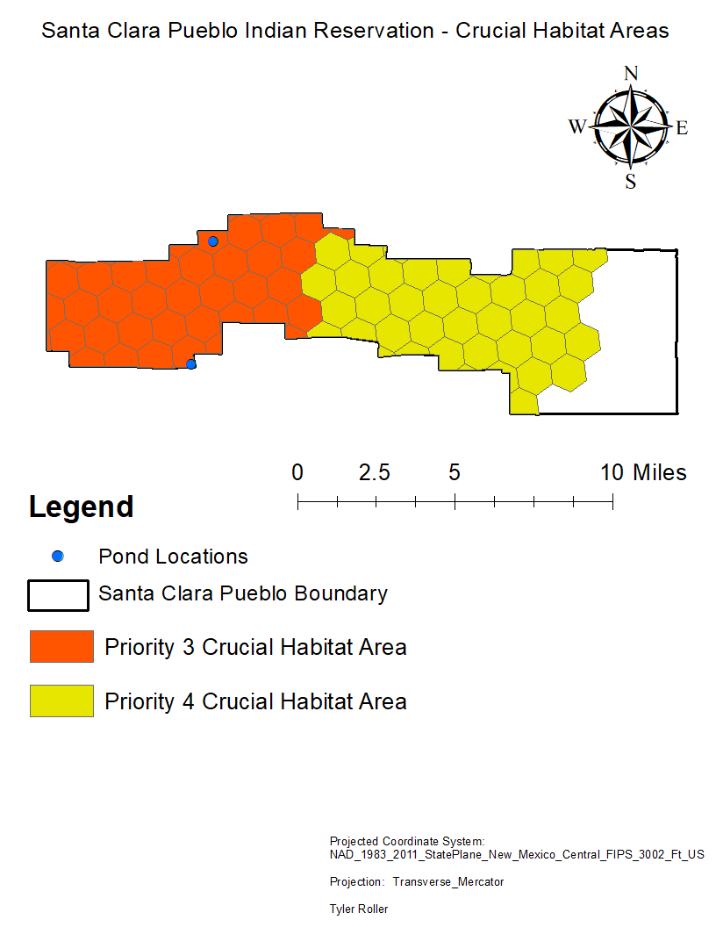
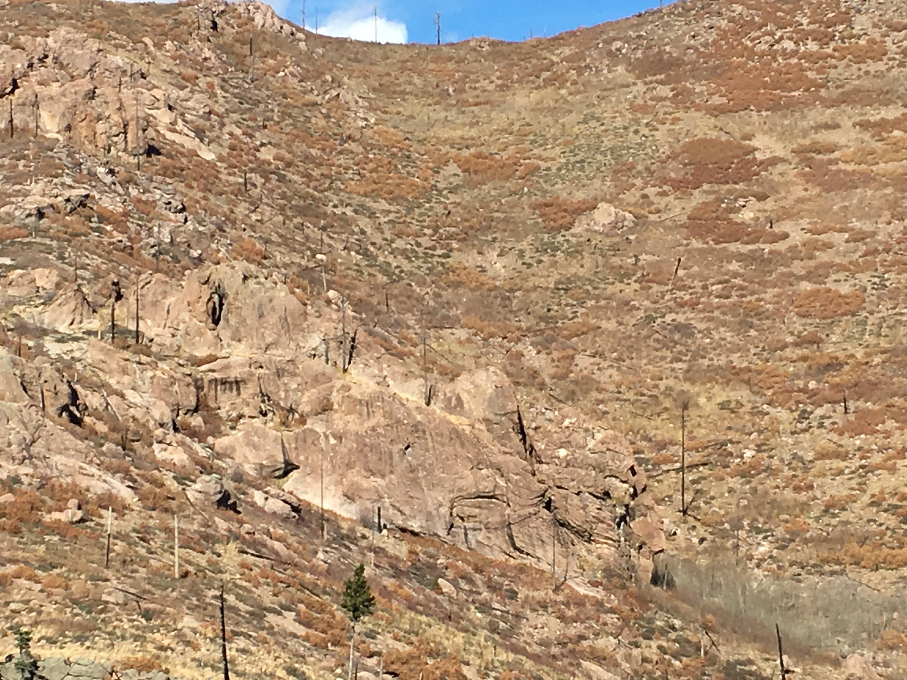
Wildlife movement
Tyler Roller
Undergraduate, Dept. of Geography and Environmental Studies
Background
Methods
Results
The Santa Clara Pueblo Indian Reservation is located Northeast of the Valles Caldera National Preserve. In the past 20 years, three wildfires have affected about 90 percent of the tribes forests and about 50 percent of its watershed. Since the most recent largest wildfire, the Las Conchas Fire, the land has areas of severe fire damage and much of the landscape has been dramatically changed. Many areas of forested lands have been reduced to bare rock.
This project will study how wildlife interact and travel through a landscape. For my research I want to utilize the Least Cost Path tool to calculate possible areas that may be travelled by terrestrial species such as big game species like Mule Deer and Elk. I want to understand why wildlife may travel certain areas as opposed to other areas of the landscape. I have also gathered field data such as GPS data of ponds filled with water. This data is crucial because wildlife is most likely to be seen here. I want to determine how water and food accessibility determine travel paths for wildlife. I also want to learn how slope of an area determines travel paths.
I gathered my required data such as a boundary shapefile, two Digital Elevation Models from USGS, land use data, GPS data of ponds in my study area and wildlife corridor data from New Mexico Crucial Habitat Assessment Tool website.
I created mosaics of DEM data to create one DEM map of my study area in ArcGIS.
I extracted DEM and Land Use data to narrow my raster data to my study area.
I reclassified my slope layer to a scale of 1-5. My land use layer was reclassified using land use codes to describe my landscape such as “Forest Upland”, “Herbaceous Upland”, and “Barren” land.
I used my reclassified slope and land use data and added them together in Raster Calculator to create my cost surface.
Using two water catchment pond locations, I first determined my origin for least cost analysis will be a pond on the Southwest side of the canyon area. My final destination will be a pond on the Northside of the canyon area. These ponds were chosen because each site shows signs of game species utilizing the water sources. The NMCHAT data also shows that each pond is located in a high priority crucial habitat area.
Cost Distance tool was used for my origin to create cost distances for my study area.
I used the Cost Path tool to create a least cost path to determine a pathway through my cost surface.
I compared my least cost path to my study area in Google Earth to determine if the pathway that is calculated is possible.
From my results I can now identify one possible travel area for big game species. The travel area spans from the Southwest side of the canyon area where a water catchment pond is located, travelling across the southern side of the canyon, down into the canyon area, up the North slope, and into the area where the Northside pond is located.
Discussions and Conclusion
From my findings, I have determined one travel area for big game species within the Santa Clara Pueblo Indian Reservation. After comparing my calculations to imagery in Google Earth and visiting my study area, I believe that my current calculations are correct and the travel area is a possible wildlife route.
Although both pond sites show signs of wildlife, to further my research on this project I plan to gather field data in this travel area to determine if wildlife actually use this route. I also want to illustrate possible wildlife travel networks in future work utilizing the least cost path tools. I will also create a more detailed cost path that will illustrate the deviation wildlife may take on the path that could not be shown due to time constraints. With this change I also plan to expand my study area passed the reservation boundary as wildlife can easily travel out of the boundary area. I believe this will improve my results as well because it will allow for a more accurate least cost path.
I believe that using a Least Cost path tool can greatly benefit the New Mexico Game and Fish and other agencies like it to determine wildlife travel patterns in crucial habitats.
References
Data Sources
New Mexico Crucial Habitat Data Set. New Mexico Crucial Habitat Assessment Tool: Mapping Fish and Wildlife Habitat in New Mexico. New Mexico Game & Fish Department and Natural Heritage New Mexico. Published 12/10/2013. Accessed 11/1/2017. http://nmchat.org/
New Mexico Resource Geographic Information System (NMRGIS) - http://rgis.unm.edu/
USGS Earth Explorer - https://earthexplorer.usgs.gov/
ASTER GDEM is a product of METI and NASA.
Santa Clara Pueblo: Developing Forest Resiliency by Tosia Shall - tshall_LNR
http://www.arcgis.com/apps/MapSeries/index.html?appid=3ca785edb04647148f34b0a4ce07439d
Google Earth Pro - https://earth.google.com/download-earth.html
fe_2007_nm_aiannh00 - shapefile data of study area from NMRGIS
NMCHAT.gdb - Priority wildlife habitat from NMCHAT
ASTGTM2_N35W107, ASTGTM2_N36W107 - DEM data of study area from Earth Explorer
Nlcdgrid - National Land Cover data from Earth Explorer
tl_2010_35_county10_shp – shapefile data of New Mexico Counties

